Slide 1
Design your own computer chips at home. Seriously.
Matt DeFano – STA Group
github.com/defano/digital-design
Monday, June 26, 2017 • 10:00am – 12:15pm • Room 208

Slide 2

Matt DeFano Sr. Architect, Manager
IOT TECHNOLOGY SOLUTIONS An STA Group Company
222 South Riverside Drive Suite 2800 Chicago, IL 60606
matt.defano@iottechnology.com www.iottechnology.com
Not an electrical engineer
Never studied electronics
Flunked algebra. Also, calculus.
🤔
Okay, I was employed as an ASIC / FGPA engineer for a Bay Area telecom startup.

Slide 3
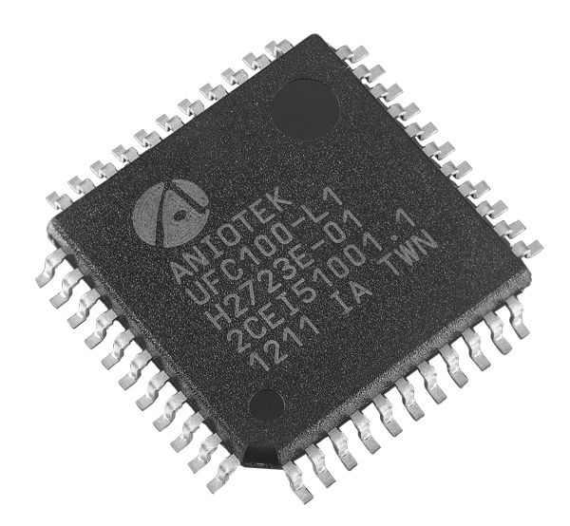
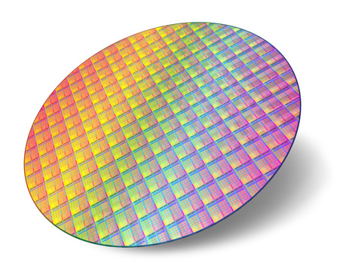
What’s the point of this talk, bald man?
Help you understand what goes into creating a digital integrated circuit
Introduce you to Verilog, a hardware description language used to design them
Show nerds (“enthusiasts”) how they can experiment at home with hobbyist hardware kits
Hands-on: design and simulate a chip to drive LEDs in a “Knight Rider” pattern

Slide 4
But we can’t cover everything. We’ll skip these more advanced topics:
How chips are physically fabricated (manufacturing process)
How to design analog or mixed-signal integrated circuits (chips containing wireless radios, micro-electro-mechanical systems, etc.)
How to design complex digital circuits that involve multiple clock domains, PLL-synthesized clocks, or SerDes’
Each and every aspect of the Verilog language (we’ll focus on the constructs you’re most likely to use)

Slide 5
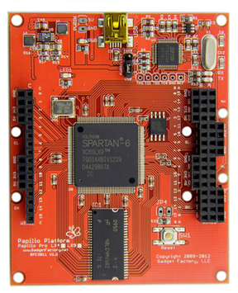
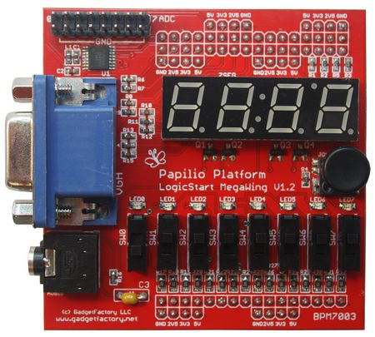
Raspberry Pi is for kids. Design integrated circuits at home.
The Papilio platform is an FPGA development kit for makers / hobbyists (others are on the market, too)
Main board contains FPGA and / or CPU; auxiliary boards (called “wings”) provide various IO options (buttons, switches, displays, etc.)
Can I use this to invent my own computer architecture? Of course!
Setups cost ~$100 at gadgetfactory.net

Slide 6
While not strictly required, some background will be helpful…
You’re Boolean bitwise You understand truth tables, the behavior of logical operators (AND, OR, XOR, etc.), and bitwise expressions (i.e., a & ~b | c)
You know number bases and SI units Never heard of binary or hexadecimal? That might be a problem. Milli, micro, nano, pico, femto…?
You’ve had some experience writing code Ideally in a C-like language (Java, JavaScript, ObjectiveC, Swift, Perl, etc.)
You’re comfortable with Linux (and a text editor) Windows (and to a lesser degree, macOS) will work, but lab instructions are targeted at Ubuntu.

Slide 7
Lets get started with a quick refresher.

Slide 8
Information can be represented numerically.
Hello
Uppercase
65 | A
66 | B
67 | C
68 | D
69 | E
70 | F
71 | G
72 | H
73 | I
74 | J
Lowercase
97 | a
98 | b
99 | c
100 | d
101 | e
102 | f
103 | g
104 | h
105 | i
106 | j
… your text message
72, 101, 108, 108, 111
… as decimal
0x48, 0x65, 0x6c, 0x6c, 0x6f
… as hex
01001000, 01101001, 01101100,
01101100, 10101111
… as binary
The American Standard Code for Information Interchange (ASCII), circa 1960s

Slide 9


Even information that doesn’t seem numerical.
0, 0, 0, 0
1, 0, 0, 0
Rasterized “bitmap” image from HyperCard, circa 1987.

Slide 10


… no matter how complex the information.
30, 32, 16, 17, 18, 14, 12
as decimal
0x1e, 0x20, 0x10, 0x11, 0x12, 0x0e, 0x0c
hex
00011110, 0010000, 00010000, …
binary
Pulse code modulation (PCM), circa 1920 (used in compact discs).

Slide 11
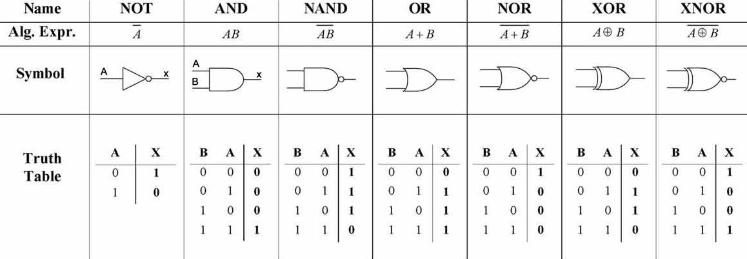
Binary data can be manipulated with Boolean algebra and drawn as a network of logic gates.
Proposed by George Boole circa 1847; you slept through this in college philosophy.

Slide 12
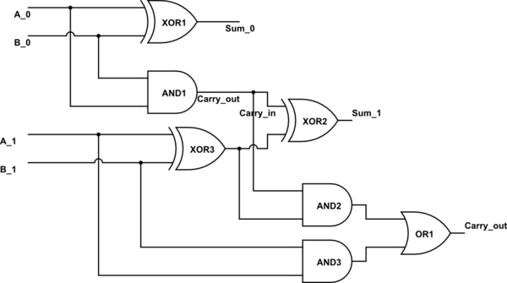
Logic gates can be arranged to produce any transformation of input to output.
Example of a circuit to add two-bit integers.

Slide 13
Every point in a digital circuit exists in only one of two states: 0 or 1.
State | Physical Representation
0 False, de-asserted | Low Voltage (usually 0v, but depends on logic standard)
1 True, asserted | High Voltage (commonly 5v, 3.3v, 1.8v or 1.2v, but depends on logic standard)
Well, not exactly. There’s these two not-quite-a-state states, too:
Z Disconnected | High Impedance (disconnected, or “floating”); connected to neither power or ground
X Unknown | Indeterminate (value cannot be predicted or is unstable); logical value only; does not have a specific electrical representation
This is commonly referred to as four-valued logic.

Slide 14
What do X and Z mean when evaluating logical expressions?
X combined with any value results in X unless short- circuit evaluation allows otherwise
Z behaves like X when evaluated (although it represents a distinct electrical state in the circuit)
y = a & b
0 | 0 | 0
0 | 0 | 1
0 | 1 | 0
1 | 1 | 1
X | 1 | X
0* | 0 | X
X | X | 1
0* | X | 0
y | a | b
y = a | b
0 | 0 | 0
1 | 0 | 1
1 | 1 | 0
1 | 1 | 1
1* | 1 | X
X | 0 | X
1* | X | 1
X | X | 0
y | a | b
* Denotes short-circuit evaluation

Slide 15
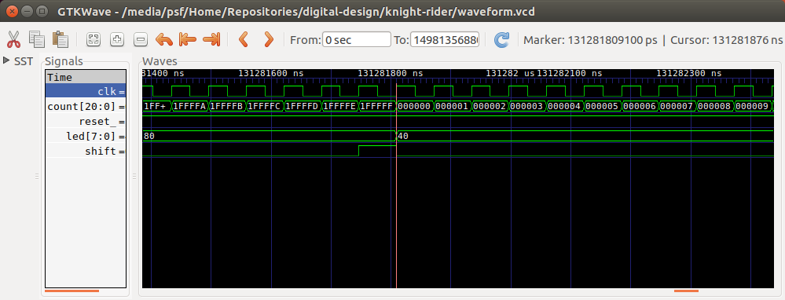
A brief lesson in the anatomy of a digital signal.
A digital waveform graphs voltage over time without any “analog” elements like curves or sine waves.
1-value True, asserted
Negative (”falling”) edge
Transition from 1 to 0
voltage
time
GTKWave - Waveform viewer
0-value
False, de-asserted
Positive (“rising”) edge Transition from 0 to 1

Slide 16
Gates are comprised of transistors, which work like electrically controlled switches.
D
Apply a bit of voltage to G (gate).
… and the switch closes; electricity flows between S (source) and D (drain).
G
Inverse polarity (P-channel) version exists, too
S
Schematic symbol for an N-channel field-effect transistor (FET)

Slide 17
Transistors can be arranged to form logic gates.
If this is a 1…
… then this is 1
… and this is also a 1…
Output of a gate changes continuously in response input.
POWER
For illustration only; not an accurate schematic of a TTL AND gate. What’s wrong with it?

Slide 18
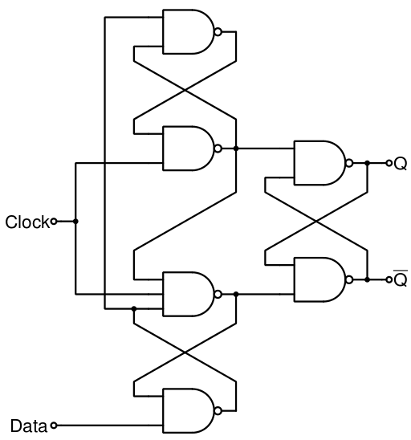
Gates can be arranged to create single-bit memories called flip-flops (“registers”).
D
Q
CLK
Referred to by this schematic symbol
This talk will deal exclusively with positive-edge triggered, D-type, flip-flops with asynchronous reset.

Slide 19
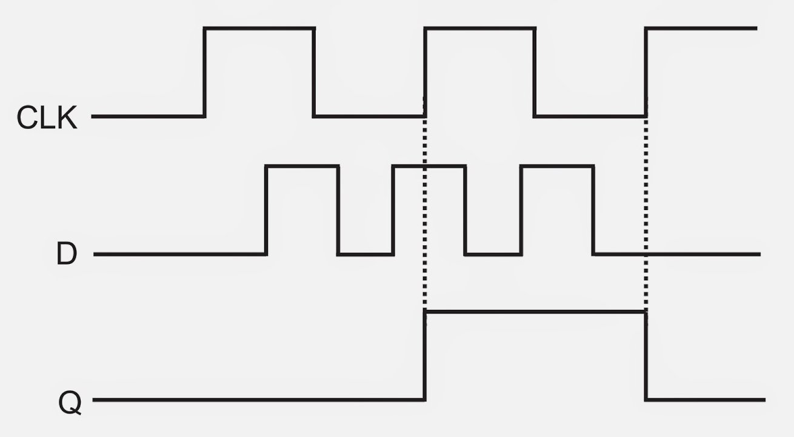
Flip-flops store their input (D) the moment the clock (CLK) changes state.
At the rising edge of the CLK input, the flip-flop samples the value of D.
The flip-flop produces a constant output until a new input is sampled at the next clock cycle.
Reset not illustrated.

Slide 20
Digital integrated circuits are simply a very large combination of gates and flip-flops.
D
Q
D
Q
CLK
CLK

Slide 21


How large a combination, you ask?
About 50,000 times
more circuitry
Macintosh Plus (c. 1986)
Motorola 68000
68 thousand transistors (~17 thousand gates)
8 million clock cycles per second (8 MHz)
iPhone 7 (c. 2016)
Apple A10
3.3 billion transistors (~825 million gates)
2.4 billion clock cycles per second (2.4 GHz)

Slide 22
The complexity of these designs is managed by expressing them in code.
Verilog | VHDL
Based on C | Based on Ada
Models hardware better | Models behavior better
More popular in the USA | More popular in Europe
More popular for ASIC design | More popular for FPGAs
Both are relatively simple languages
Chip design is actually software engineering (ssh, don’t tell the hardware engineers).

Slide 23
Code written in a hardware description language is synthesizable into digital circuits.
reg wr_en;
always@(posedge clk or negedge reset_)
if (!reset_)
wr_en <= 1’b0;
else
wr_en <= cs & !rnw;
Code “compiles” into a hardware design
Verilog
cs
D
Q
wr_en
rnw
NOT
AND
clk
CLK
reset_
NOT
CLR
DFF W/ CLR

Slide 24
Cool. I’ve “written” my first integrated circuit. So how does it become a chip?
Contract with a manufacturer to fabricate your design into an ASIC (application-specific integrated circuit)
Load your design into a programmable logic device such as an FPGA (field-programmable gate array)
A custom chip that’s manufactured to your specifications; approximately six-figure up-front cost (NRE) with per-unit costs dependent on size / complexity.
An off-the-shelf chip that contains thousands-to-millions of gates and flip-flops whose interconnections are programmable to match the behavior of your design. Each part costs somewhere between a few bucks and the price of a nice car.
🤔
Deploy your chips in the cloud: AWS now offers FPGA-equipped EC2 instances.

Slide 25



Don’t kid yourself. An FPGA is real hardware, not some kind of circuit simulator.
FPGA
Contains a whole pile of pieces. You assemble only those you need into your design (and the rest come along for the ride).
ASIC
Contains only the pieces you utilize in your design.

Slide 26
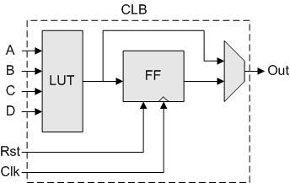
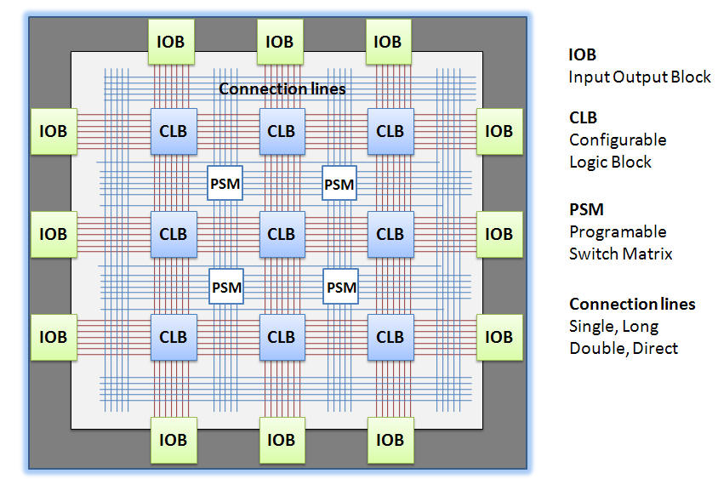
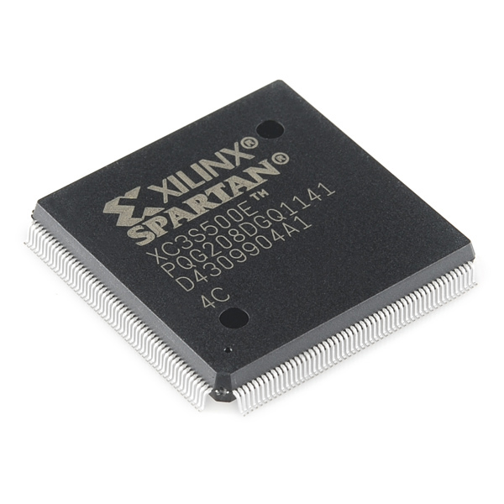
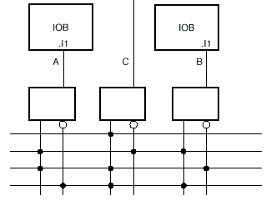
An FPGA contains logic gates whose inter-connections are electronically programmable.
Complex Logic Block
Programmable Switch Matrix
I/O Blocks (pins)

Slide 27
Every chip needs two special inputs:
A clock signal that oscillates between 0 and 1 at fixed frequency; causes flip-flops to sample their input. (Commonly generated by a crystal oscillator external to the chip.)
A reset signal used to initialize flip-flops to a default state. (Typically driven by a power control circuit and/or a reset button.)
32MHz freq = 31.25ns period
CLK
In reset
Out of reset (running)
RESET

Slide 28
Propagation delay limits how quickly logical expressions are evaluated in hardware.
Each gate in the combinatorial pipeline introduces propagation delay. The total delay may not exceed the period of clock*.
y <= ~x;
Verilog
Q
D
X_{Q}
x
y
Y_{D}
T
Delay
T
Delay
* Except under unusual and intentionally-designed circumstances.

Slide 29
Setup and hold times are the traffic cops of the digital world.
The input to a flip-flop (D) must be stable for a brief moment before and after the clock ticks:
T
T
Setup
Hold
CLK
D
Input can change
stable
Input can change
Otherwise, the output of the flip-flop is indeterminate (X): Could be a 1; could be a 0, or could be metastable (indeterminate).

Slide 30
Three environmental variables affect real-world propagation delay:
Process Variations in the manufacturing process affect the speed at which transistors operate.
Voltage As voltage increases, delay decreases.
Temperature
Higher temperatures result in greater delay.
If you’ve ever tried to overclock a PC, you probably fiddled with these variables.

Slide 31
Verilog for Software Engineers

Slide 32
Verilog is a hardware description language used to design, simulate and describe digital circuits.
Invented in 1985, standardized in ’95, and updated a few times since.
Software engineers will find Verilog quite simple:
No complex types, abstractions or language semantics
No standard libraries or frameworks to master
But also quite difficult:
Entirely new programming paradigm; requires you think about problem solving in a different way
Parallelism is free; sequential consistency is expensive
We’ll focus on Verilog ’95; later versions add syntactical sugar and sophisticated testing constructs.

Slide 33

Verilog is like having three languages in one! Order now!
Behavioral syntax for simulating circuits The entire language syntax including constructs that could never be realized in hardware (i.e., no silicon equivalent of the $display task)
Register-transfer level syntax for designing circuits Called “RTL”; this subset of the language is used to model the flow of data in a pipeline of register → logic → register. We’re mainly interested in this subset.
Structural syntax for describing synthesized circuits Used to describe circuits that have been “compiled” into cells (circuit components like flip-flops and gates), and the wires that interconnect them. Verilog compiles into Verilog.

Slide 34
Verilog is converted to hardware through a process called synthesis.
You write…
Synthesis software produces…
Your chip contains…
RTL Verilog
Gate Level Netlist
Physical Hardware
assign y = z & ~r;
wire y, z, r, s;
NOT1 not00000 (
.a(r),
.q(s)
);
AND2 and00001 (
.a(z),
.b(s),
.q(y)
);
z
a
y
r
a
q
s
b
q
Synthesis process replaces high-level behavioral language constructs with a network representation of pre-defined manufacturer-specific circuit components called “cells”.
Netlist has a one-to-one relationship with physical hardware.
Verilog “compiles” into Verilog. “Backend” EDA tools convert the compiled Verilog to physical hardware.

Slide 35



Electronic design automation (EDA) tools convert HDL code into physical silicon.
Simulation | Lets designers test their circuits before conversion to hardware
Synthesis | Translates HDL code into a list of gates and the interconnections between them
Verification | Assures that physical circuitry performs equivalently to simulation
Place & Route | Determines optimal physical location and placement of gates on silicon chip
Mask Prep | Generation of lithography photomasks for manufacturing

Slide 36
module counter (
reset_,
clk,
enable,
count
);
input reset_;
input clk;
input enable;
output [7:0] count;
reg [7:0] count;
wire [7:0] next_count;
assign next_count = count + 8’h1;
always@ (posedge clk or negedge reset_)
if (!reset_)
count <= 8’h00;
else if (enable)
count <= next_count;
endmodule
A Quick Look
This circuit outputs an 8-bit value (called count) that increments each clock cycle in which the enable signal is asserted (1’b1).

Slide 37
Module Definition
Specifies the name of this circuit and the connections it makes to the outside world.
As a matter of convention, signals ending with an underscore (reset_) are “active low.” That is, the circuit is in reset when this signal is zero.
Active high signals are asserted when their value is one.
module counter (
reset_,
clk,
enable,
count
);
input reset_;
input clk;
input enable;
output [7:0] count;
reg [7:0] count;
wire [7:0] next_count;
assign next_count = count + 8’h1;
always@ (posedge clk or negedge reset_)
if (!reset_)
count <= 8’h00;
else if (enable)
count <= next_count;
endmodule

Slide 38
module counter (
reset_,
clk,
enable,
count
);
input reset_;
input clk;
input enable;
output [7:0] count;
reg [7:0] count;
wire [7:0] next_count;
assign next_count = count + 8’h1;
always@ (posedge clk or negedge reset_)
if (!reset_)
count <= 8’h00;
else if (enable)
count <= next_count;
endmodule
Port Definitions
Specifies the direction (input, output or bidir) of the ports and their width.
[7:0] implies that the count signal consists of eight physical wires grouped together as one logical value.
Each connection in the module definition should have a corresponding IO declaration.

Slide 39
module counter (
reset_,
clk,
enable,
count
);
input reset_;
input clk;
input enable;
output [7:0] count;
reg [7:0] count;
wire [7:0] next_count;
assign next_count = count + 8’h1;
always@ (posedge clk or negedge reset_)
if (!reset_)
count <= 8’h00;
else if (enable)
count <= next_count;
endmodule
“Variable” Declarations
reg infers flip-flops;
wire infers nets (connections)
Registers store data. The value of a register when evaluated in an expression is its output (Q).
Wires transmit data. The value of a wire changes immediately in response to the logical expression assigned to it.

Slide 40
module counter (
reset_,
clk,
enable,
count
);
input reset_;
input clk;
input enable;
output [7:0] count;
reg [7:0] count;
wire [7:0] next_count;
assign next_count = count + 8’h1;
always@ (posedge clk or negedge reset_)
if (!reset_)
count <= 8’h00;
else if (enable)
count <= next_count;
endmodule
Combinatorial Logic
assign keyword used to “assign” a logical expression to a wire.
Note that the value of next_count changes continuously in response to the adder circuit (count + 8’h1).
Assignment is “delayed” by propagation delay through adder.

Slide 41
module counter (
reset_,
clk,
enable,
count
);
input reset_;
input clk;
input enable;
output [7:0] count;
reg [7:0] count;
wire [7:0] next_count;
assign next_count = count + 8’h1;
always@ (posedge clk or negedge reset_)
if (!reset_)
count <= 8’h00;
else if (enable)
count <= next_count;
endmodule
Sequential Logic
Defines the behavior of all eight ([7:0]) count flip-flops.
Generally, all flip-flops should follow this template: activated by edge of clock or edge of reset.
Body is a single if-else statement defining the behavior of each condition.

Slide 42
module counter (
reset_,
clk,
enable,
count
);
input reset_;
input clk;
input enable;
output [7:0] count;
reg [7:0] count;
wire [7:0] next_count;
assign next_count = count + 8’h1;
always@ (posedge clk or negedge reset_)
if (!reset_)
count <= 8’h00;
else if (enable)
count <= next_count;
endmodule
Module Closure
endmodule keyword required to close module.
Verilog allows multiple modules to be defined in the same file, but considered a bad practice.
By convention, file is named after the module, i.e., counter.v

Slide 43
Verilog is based on C (it may look familiar).
Verilog is case sensitive and whitespace insensitive; uses C-standard // and /* for comments
Loosely typed; everything is an unsigned integer*
Has equivalent control flow constructs (if/else, for, case, etc.)
Supports a superset of the C expression language (i.e., +, -, *, /, ~, !, <, <<, etc.)
One notable difference: Compound statements (blocks) are delimited Pascal-style with begin and end
if (x < y) begin
// something interesting
end
* Not exactly true, but good enough for the purposes of this talk.

Slide 44

Remember that you’re describing hardware, not executing instructions. Therefore, the lexical order of statements usually doesn’t matter. (I’ll wait while you get ahold of yourself.)
assign a = b & c;
assign d = ~e ^ f;
assign d = ~e ^ f;
assign a = b & c;
This is the same… as this!
always@(posedge clk)
begin
a <= b;
b <= a;
end
always@(posedge clk)
begin
b <= a;
a <= b;
end
whoa!

Slide 45

Verilog offers you plenty of rope to hang yourself (illustrated instructions included).
You can write perfectly valid Verilog that…
Cannot be converted (“synthesized”) to hardware
Behaves differently in simulation than in silicon
Behaves differently depending on tool vendor
Is completely impossible to debug or reason about*
This talk will describe Verilog as you ought to use it, not as it could be used (we’re not aiming for a definitive language guide).
* Not unique to Verilog.

Slide 46
A module is the primary unit of abstraction in Verilog.
A module represents a complete (sub-)circuit that exposes a set of inputs and outputs
All code must exist inside of a module (like Java)
One module definition per file (by convention, also like Java)
A signal inside the module whose name matches that of an input or output is considered connected to that IO.
module inverter(
in,
out
);
input in;
output out;
wire out;
assign out = ~in;
endmodule

Slide 47
A Verilog design consists of a tree-hierarchy of modules:
The “top” (root) of the hierarchy represents the inputs / outputs of your chip (called the pin-out)
A module can contain (instantiate) other modules…
… but cannot instantiate itself or another module that instantiates it (no cycles)
module uart_top(
clk,
reset_,
...
);
transmitter tx1(
.clk(clk),
.reset_(reset_),
.tx(tx),
.data_out(data_out)
);
...
endmodule

Slide 48
What’s the syntax for defining a new module?
Declares a module called my_chip (by convention, defined in a file titled my_chip.v)
module my_chip (
clk,
reset_,
data_in,
data_out);
input clk;
input reset_;
input [7:0] data_in;
output [7:0] data_out;
// Your logic here
endmodule;
Input and output signals. No width specifiers in this list.
Each port (above) must have a corresponding input or output statement. Multi-bit values must have their width specified.
Your logic followed by the endmodule keyword.

Slide 49
How do I instantiate a submodule inside of an existing module?
Instantiates a receiver named rx1. Module names are used to differentiate signals in waveform viewer.
module transceiver (
...
receiver rx1 (
.clk(clk),
.reset_(reset_),
.data_in(serdata),
.data_out(pardata)
);
...
endmodule
Dot-value (.data_in) refers to the name of the input/output defined by receiver. Value in parentheses (serdata) is a signal defined in the current module.
Verilog does not require all ports to be connected, but considered bad practice not to.

Slide 50
Integer literals in Verilog specify width and radix:
20’h4_beef
Size of integer (in bits) | Case-insensitive radix of literal expression. Acceptable values: H – Hexadecimal (base 16) D – Decimal (base 10) O – Octal (base 8) B – Binary (base 2) | 0..1 in binary expressions; 0..7 in octal; 0..9 in decimal; 0..9, a..f in hexadecimal. _ is for readability. Also: Z or ? to represent “high impedance” (nothing), or X to represent unknown (in simulation, only)

Slide 51
Verilog adds new operators to C’s repertoire.
Concatenation {}
Combines two or more values into a single logical value.
Replication {{}}
Duplicates a value some number of times.
Reduction &, |, ^
Performs a bitwise operation across all bits of a value producing a single-bit result.
Four-valued Equality ===
Compares two values; == results in X if any bit in either value is X or Z. (Simulation only.)
{3’b111, 1’b0} // 1110
{2 {2’b10}} // 1010
&4’b1011 // 0
|4’b1011 // 1
2’b11 == 2’bx1 // x
2’b11 == 2’b1z // x
2’b1x === 2’b1x // 1
2’bzx === 2’bzx // 1

Slide 52
There are two kinds of assignments in Verilog. (It’s best if you not think too much about this.)
<= | =
Non-blocking assignment | Blocking assignment
Use inside always@ blocks | Use with assign statements
All assignments in a compound statement execute at the same time (in parallel) | All assignments in a compound statement execute sequentially
Behaves like hardware | Behaves like software
A common source of confusion among beginners; best to paint-by-numbers at first.

Slide 53
Verilog has two variable types: wire and reg.
wire | reg
Models a connection (net) between two circuit elements | Models a flip-flop or latch (like a variable in software)
Transmits value; does not store value | Transmits and stores value
Value changes continuously with respect to | Value changes when clock ticks or reset is asserted
Assigned using the assign statement | Assigned inside of an always@ block
All module IOs are implicitly declared as wires (unless a reg of the same name exists) | Can drive module outputs but cannot be connected to an input (have the same name as an input signal)
Resist the urge to think of these as “data types;” they both hold the same type of data: bits.

Slide 54
Wires and regs can be grouped together into a single logical value called a vector, Victor.
Bits in a vector can be accessed independently or as a subset using a part select index.
Size of a vector declaration must be constant at compile time. (How come?)
Part select index does not need to be constant; but the resulting width must be.
wire single_bit;
wire [7:0] eight_bit;
reg [31:0] thirtytwo_bit;
reg [3:0] four_bit;
assign eight_bit[0] = 1’b1;
assign x = eight_bit[7:4] & thirtytwo_bit[3:0];
always@(...)
thirtytwo_bit <= 32’h00000000;
four_bit[x] <= y;

Slide 55
Wires transmit value but do not hold state
Value changes continuously in response to assigned stimulus
Assigned using the = operator and the assign keyword.
May be connected to the input or output of an instantiated module or a reg.
All inputs and outputs are inferred as wires (unless a reg of the same name exists—allowable only for outputs)
wire wr_en;
assign wr_en = cs && !rnw;
wire [15:0] counter_val;
counter counter_inst (
.counter_out(counter_val)
);

Slide 56
Registers model flip-flops; assignment is triggered by a clock edge or a reset signal.
Value changes in response to a trigger (i.e., clock or reset)
Assigned inside an always@ block using the <= operator
May be connected to the input of an instantiated submodule (but cannot accept the output).
...
reg [7:0] counter;
always@ (posedge clk or negedge reset_)
if (!reset_)
counter <= 8’d0
else if (counter_enable)
counter <= counter + 8’d1;
...

Slide 57
A point of confusion when using wires and regs:
Wires…
Can be connected to the inputs or outputs of their own module or any instantiated submodule
Registers…
Can be connected to the inputs of an instantiated submodule (that is, they can drive an input)
Can be connected to the output of their own module
Cannot be directly connected the output of an instantiated module (registers must be clocked with an always@ block)

Slide 58
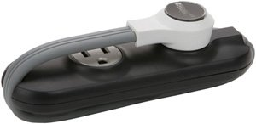
Combinatorial assignments in Verilog are modeled with an assign statement:
assign wr_en = cs & ~rnw;
Left-hand value must be a wire and only one assignment per wire. | Always use blocking assignment (=) in assign statements. | Terms on the right-hand side can be wire, reg or literal values.
assign a = b + c;
assign b = a + d;
No cycles allowed in assignments.

Slide 59
The always@ statement is used to model flip-flop assignments.
always@(posedge clk or negedge rst)
always@ is used to model flip-flop assignments in Verilog. This form (with a posedge x or negedge y activation list) models D flip-flops with async reset. | Indicates this block “executes” whenever the clk signal transitions from a 0 to a 1. Used to specify the clock input to the flip-flop. | Indicates this block “executes” whenever the rst signal transitions from a 1 to 0. Used to specify the async reset for the flip-flop.

Slide 60
By convention, your always@ blocks should follow this template:
Body of an always@ block should be an if-statement
always@(posedge clk or negedge reset_)
if (!reset_)
counter <= 8’h00;
else if (increment)
counter <= counter + 8’d1;
else // decrement case
counter <= counter – 8’d1;
First condition is reset; right-hand side is constant and not gated with other signals.
Subsequent conditions define “running” state (define as many as you like).
Do not assign the same reg from multiple always@ blocks.

Slide 61
Clocks and resets are special snowflakes inside your chip. Don’t mess with ‘em (or Texas).
Don’t gate the clock
The clock should not appear as a term in logical expressions (or really anywhere outside of a flip-flop’s sensitivity list).
Clocks trigger flops
Only clock and reset belong in the always@ sensitivity list. Don’t use other signals! Use if/else conditionals instead.
Use constant reset values
The value assigned to a register in the reset condition should be an integer literal, not an expression.
assign x = clk || y;
always@(posedge cntr_en ...)
always@(... or negedge rst_)
if(!reset_)
x <= y + z;
else
...
These represent bad practices and code smells, not formal language requirements.

Slide 62
What’s safe to use in synthesizable Verilog?
wire and reg declarations
assign statements (for combinatorial logic)
always@ blocks (triggered by posedge clk or negedge reset_) to model flip-flops
Logical, bitwise and arithmetic expressions (division not allowed; multiply should be used with caution)
if and case (switch) conditional constructs. Ternary conditional expression ( ?: ) is your friend.
Instantiation of other modules
Not an exhaustive list (but representative of the most common language elements).

Slide 63
A quick peek at simulating circuit designs.

Slide 64
A Verilog testbench is used to simulate a circuit.
A testbench provides stimulus (input) to a circuit under test, generates waveform output and verifies correctness:
Can be written to verify correctness of a single module (like a unit test) or an entire design hierarchy (like an integration test)
Generates input signals like clock and reset
Testbenches are not intended to be synthesized into silicon so they’re free to use the full Verilog syntax, including:
Timing and delay statements
System tasks
Procedural language constructs
Subsequent slides introduce syntax that can be used only in testbenches.

Slide 65
module testbench ();
reg clk;
reg reset_;
wire [7:0] leds;
knightrider uut (
.clk(clk), .reset_(reset), .leds(leds)
);
initial begin
$dumpfile("waveform.vcd"); $dumpvars();
clk <= 1’b0;
reset_ <= 1’b0;
#100;
reset_ <= 1’b1;
end
initial forever begin
#31.25; clk <= ~clk;
end
endmodule
A Quick Look
This testbench generates clock and reset inputs to our Knight Rider circuit under test and produces waveform output (waveform.vcd)

Slide 66
Module Definition
Note that our testbench module defines no inputs or outputs.
module testbench ();
reg clk;
reg reset_;
wire [7:0] leds;
knightrider uut (
.clk(clk), .reset_(reset), .leds(leds)
);
initial begin
$dumpfile("waveform.vcd"); $dumpvars();
clk <= 1’b0;
reset_ <= 1’b0;
#100;
reset_ <= 1’b1;
end
initial forever begin
#31.25; clk <= ~clk;
end
endmodule

Slide 67
module testbench ();
reg clk;
reg reset_;
wire [7:0] leds;
knightrider uut (
.clk(clk), .reset_(reset), .leds(leds)
);
initial begin
$dumpfile("waveform.vcd"); $dumpvars();
clk <= 1’b0;
reset_ <= 1’b0;
#100;
reset_ <= 1’b1;
end
initial forever begin
#31.25; clk <= ~clk;
end
endmodule
Variable Declarations
Notice how inputs to the unit under test are reg; outputs are wire.

Slide 68
module testbench ();
reg clk;
reg reset_;
wire [7:0] leds;
knightrider uut (
.clk(clk), .reset_(reset), .leds(leds)
);
initial begin
$dumpfile("waveform.vcd"); $dumpvars();
clk <= 1’b0;
reset_ <= 1’b0;
#100;
reset_ <= 1’b1;
end
initial forever begin
#31.25; clk <= ~clk;
end
endmodule
Instantiation of Unit Under Test
knightrider is the name of the circuit we’re testing. This connects that module’s input to our test stimulus.

Slide 69
module testbench ();
reg clk;
reg reset_;
wire [7:0] leds;
knightrider uut (
.clk(clk), .reset_(reset), .leds(leds)
);
initial begin
$dumpfile("waveform.vcd"); $dumpvars();
clk <= 1’b0;
reset_ <= 1’b0;
#100;
reset_ <= 1’b1;
end
initial forever begin
#31.25; clk <= ~clk;
end
endmodule
Test Initialization
Initial block executes at the beginning of the simulation (time 0)
$dumpfile/$dumpvars instructs simulator to generate waveform output.

Slide 70
module testbench ();
reg clk;
reg reset_;
wire [7:0] leds;
knightrider uut (
.clk(clk), .reset_(reset), .leds(leds)
);
initial begin
$dumpfile("waveform.vcd"); $dumpvars();
clk <= 1’b0;
reset_ <= 1’b0;
#100;
reset_ <= 1’b1;
end
initial forever begin
#31.25; clk <= ~clk;
end
endmodule
Register Initialization
The value of clk and reset_ are 1’bx until we initialize them to some other value.

Slide 71
module testbench ();
reg clk;
reg reset_;
wire [7:0] leds;
knightrider uut (
.clk(clk), .reset_(reset), .leds(leds)
);
initial begin
$dumpfile("waveform.vcd"); $dumpvars();
clk <= 1’b0;
reset_ <= 1’b0;
#100;
reset_ <= 1’b1;
end
initial forever begin
#31.25; clk <= ~clk;
end
endmodule
Reset
Wait 100ns, then de-assert reset signal.
(Recall that reset_ is asserted when 0)

Slide 72
module testbench ();
reg clk;
reg reset_;
wire [7:0] leds;
knightrider uut (
.clk(clk), .reset_(reset), .leds(leds)
);
initial begin
$dumpfile("waveform.vcd"); $dumpvars();
clk <= 1’b0;
reset_ <= 1’b0;
#100;
reset_ <= 1’b1;
end
initial forever begin
#31.25; clk <= ~clk;
end
endmodule
Clock Generation
This forever block is an infinite loop; each 31.25ns, toggle clk.
Produces a 32Mhz clock signal.

Slide 73
Timing and delay statements control the resolution and execution of the simulation.
Timescale
Use the `timescale directive to specify a simulation resolution and normative timescale.
First value specifies the unit of time denoted by delay statements (i.e., #7 means 7ns)
Second value indicates smallest unit of time “visible” to to the simulation (values rounded to this magnitude).
Delay
The # operator delays execution of subsequent statements in the block. x is 16’h00 at beginning of simulation; 16’hff 5ns later.
`timescale 1ns / 100ps
initial begin
x[15:0] <= 16’h00;
#5;
x[15:0] <= 16’hff;
end

Slide 74
A variety of system tasks provide hooks to control the simulator.
System tasks are special commands whose name is preceded by $ (Verilog defines about a dozen more, too):
$finish
Ends the simulation.
$dumpfile(<filename>)
Specifies the name of the file that waveform data should be written to.
$dumpvars
Tells the simulator to begin writing waveform data to the dumpfile.
`timescale 1ns / 100ps
module my_testbench ();
initial begin
$dumpfile(”waveform.vcd”);
$dumpvars();
#1000;
$finish
end
endmodule

Slide 75
Initial and forever constructs are your primary building blocks for testbenches.
Initial
Executes at the beginning of the simulation (time zero). Useful for initialization and other test logic. Note that a testbench may have as many initial blocks as it wishes (each executes in parallel).
Forever
Executes statements in an infinite loop; useful for generating clock signals.
Generates a 32Mhz clock signal.
initial begin
clk <= 1’b0;
reset_ <= 1’b1;
end
`timescale 1ns / 100ps
initial forever begin
#31.25;
clk <= ~clk;
end

Slide 76
At last, you’re ready to synthesize to hardware.

Slide 77
How do I map physical pins on the FPGA to inputs / outputs in my design?
A user constraints file (UCF) provides information about the physical pin-out of your chip (including a mapping to signals in the design).
Name of a top-level I/O in your design
Name of a pin on the Xilinx chip
NET CLK LOC="P94" | IOSTANDARD=LVTTL | PERIOD=31.25ns; NET RESET_ LOC="P114" | IOSTANDARD=LVTTL;
NET LED<0> LOC="P123" | IOSTANDARD=LVTTL | DRIVE=8 | SLEW=SLOW;
NET LED<1> LOC="P124" | IOSTANDARD=LVTTL | DRIVE=8 | SLEW=SLOW; NET LED<2> LOC="P126" | IOSTANDARD=LVTTL | DRIVE=8 | SLEW=SLOW;
LED<0> is represented as LED[0] in Verilog.
Logic standard (LVTTL is 0v-3.3v)
Extra information about the signal like drive strength (current) and clock period

Slide 78
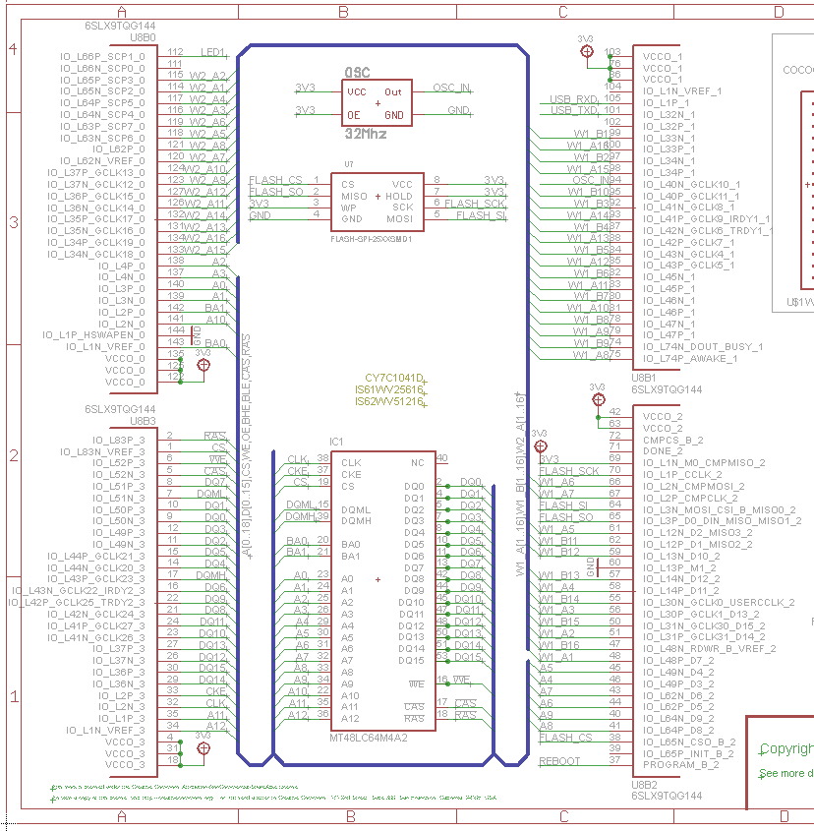
How do I know which pin on the FPGA connects to the LEDs on my circuit board?
Sorry, Charlie. There’s no magic. You’ll have to read the electrical schematic.
The Papilio site lists pin numbers and hardware connections in tabular format.
Papilio schematics are also available on their website.
Don’t screw up. Misconnecting pins can damage the FPGA or circuit board.
Perhaps more straightforward than it seems. This does not require an electrical engineering degree.

Slide 79
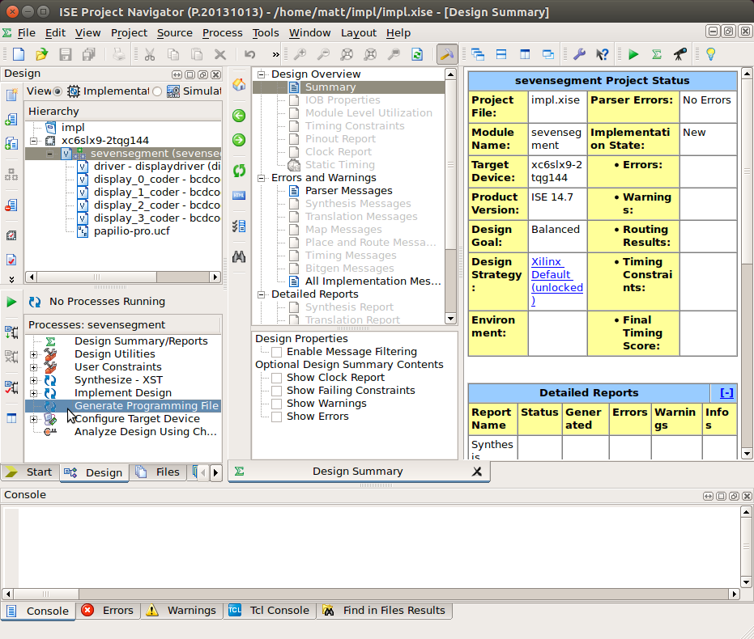
How do I get my Verilog onto the FPGA?
Xilinx provides GUI and command-line tools for “implementing” your design in hardware.
It’s not hard. I promise.
Detailed installation and implementation instructions are available on my GitHub.

Slide 80
Knight Rider Hands-on Lab Exercise

Slide 81

Goals of the Knight Rider hands-on lab exercise are to:
Author a circuit that animates eight LEDs in a back-and-forth pattern reminiscent of Kit from Knight Rider
Simulate the circuit using Icarus Verilog
View simulated waveform output in GTKWave
Demonstrate how to synthesize and load the design on the Papilio hardware
Please refrain from Hassling the Hoff during any point of this exercise

Slide 82
This circuit can be decomposed into the following pieces:
An eight-bit register, each bit of which drives a LED. A 1 turns the LED on, a 0 turns it off.
A counter that rolls over (saturates) at the frequency you want the LEDs to change. A frequency divider… How many bits must this register have if it increments every 31.25ns and should roll over approximately every 100ms?
Logic to shift the active LED one spot left or right each time the counter saturates. Use << or >> to shift left or right.
Logic to track whether we’re shifting left or shifting right. A state variable of sorts.

Slide 83
How do I get started…
Install and launch the Ubuntu VM and log in as user chicago, password coder
Navigate to the ~/digital-design/knight-rider/ project directory
Modify the rtl/knightrider.v design file.
Execute make in the knight-rider/ directory to run the simulation.
View the waveform using $ gtkwave waveform.vcd

Slide 84
Where to now? Detailed instructions and sample projects available on GitHub.
github.com/defano/digital-design
Detailed installation and setup instructions. Including instructions for loading designs onto Papilio hardware.
Learn by experimenting with working examples.
Several example projects that you can simulate, synthesize and modify.

